Slide 1


15-minute
Foundational
Number Sense
Daily Routine
Top Ten Mathematics
Counting songs that progress
students’ chant sequence
One-minute rolls for early subitising, leading to strong
part-part-whole foundations
Ninja sliders to develop instinctive trust in early number facts and missing parts (ways to make and break 3-10, fact families)
Digit roads to develop long-term muscle memories for correct and neat digit formations (avoiding reversals)
The Power and Joy of
Hands-on Numeracy
www.toptenmaths.com

Slide 2
1. Counting song as students settle back into the classroom or during transitions/eating times/brain breaks (progressing their chant sequence as high as possible, front-loading teens and skip-counting).
2. One-minute roll of dice at point-of-need, while buddy checks and collects token points to tally a PB score for that dice (only ever race against yourself).
3. Ninja slider practice with number bond recording in a write-and-wipe sleeve (trust in the count and strong part-part-whole and fact families for 3 to 10).
4. Digit roads (building strong muscle memories and avoiding reversals of digits over the long-term).
5. Optional: Counting/estimation handful (option A) or understanding teen numbers (option B).
Daily routine options (ideally three each day)

Slide 3
For all YouTube links, click the PLAY button, then click the YouTube logo once it appears to be taken to the full-screen version.
Click play, then click the YouTube logo for full-screen

Slide 4
Click Play button in the centre, then click the YouTube logo on the bottom right for full-screen
Each slide has counting songs that could be used throughout the term – four slides for options throughout each of the four terms.
We encourage teachers to stay with the same song all week, played at least five times before changing to a new song, but revisiting songs from past terms can also be beneficial depending on students’ points-of-need, or even playing one song pitched for support and another pitched for extension.
The list is a menu and should be guided by teacher selection based on points-of-need.

Slide 5
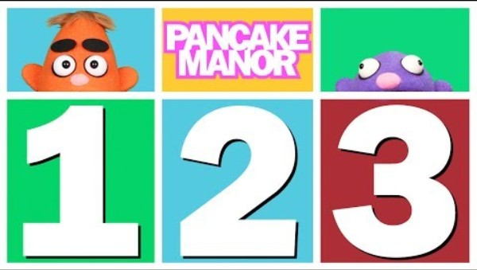
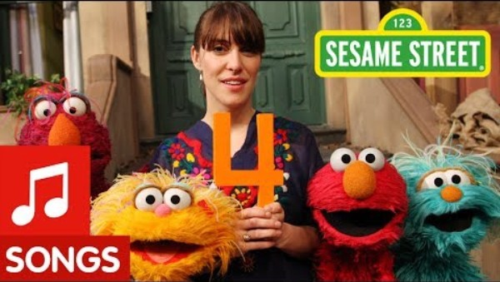


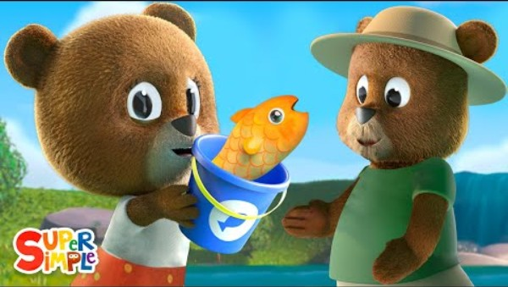
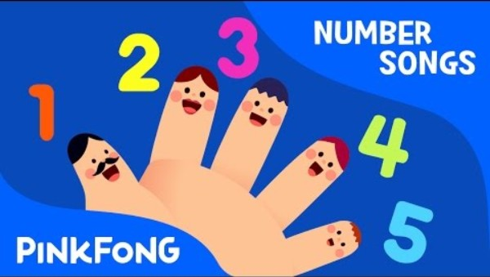

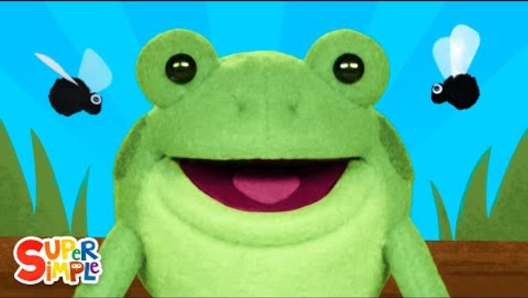
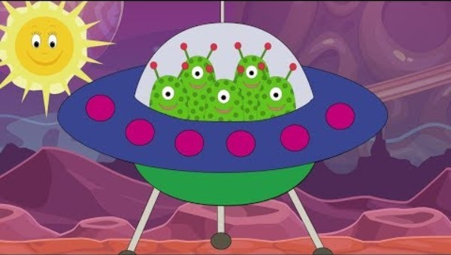


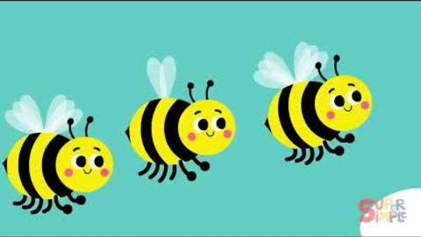
Counting songs
Counting songs
Click play, then click the YouTube logo for full-screen
Term 1
Progression:
Count to 3
Count to 5 and backwards
Count to 7
Count to 10 and backwards
Count to 20 and backwards
Count to 200 by tens (continue as a class, even if songs stop earlier than this)
Count to 120 by ones (continue as a class, even if songs stop earlier than this)
Count to 200 by ones
Count to 200 by fives (continue as a class, even if songs stop earlier than this)
Count to 120 by twos
3
4
4
5
5
5
5
5
5
7
10
10
Notes:
To 20
Backwards from 10

Slide 6





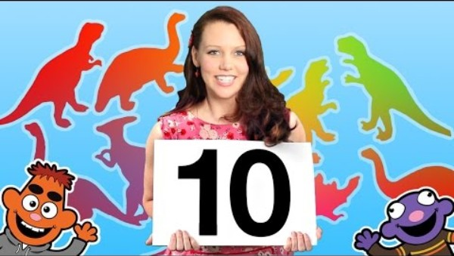
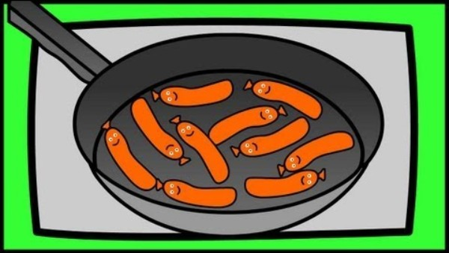
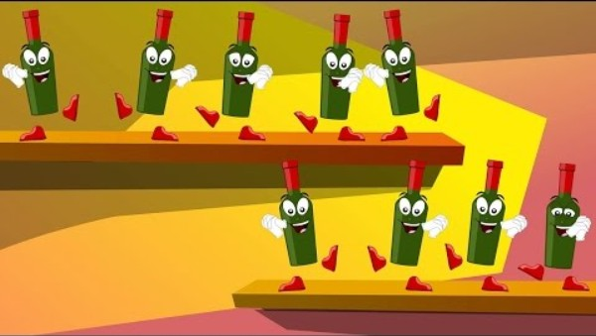

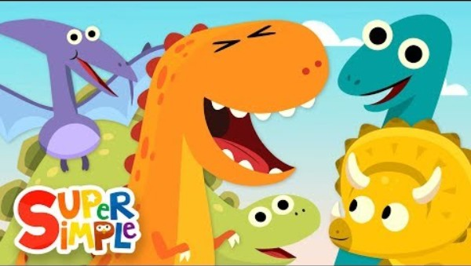

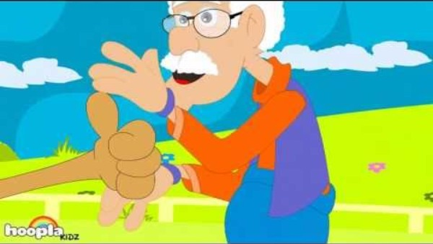
Counting songs
Click play, then the YouTube button for full-screen
Counting songs
Term 2
Progression:
Count to 3
Count to 5 and backwards
Count to 7
Count to 10 and backwards
Count to 20 and backwards
Count to 200 by tens (continue as a class, even if songs stop earlier than this)
Count to 120 by ones (continue as a class, even if songs stop earlier than this)
Count to 200 by ones
Count to 200 by fives (continue as a class, even if songs stop earlier than this)
Count to 120 by twos
10
10
10
10
10
10
10
10
10
10
10
10

Slide 7
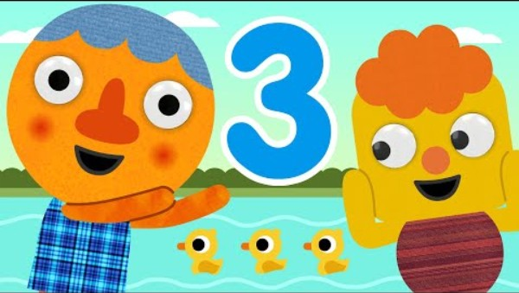
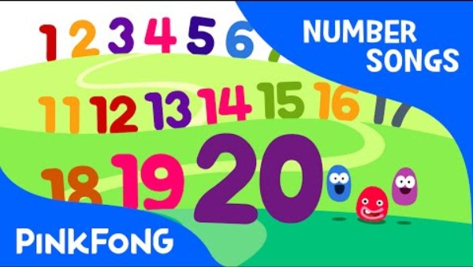
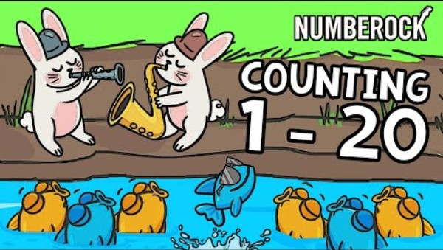
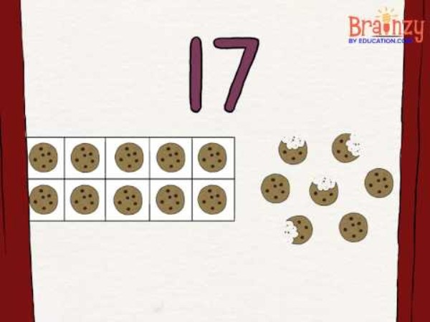
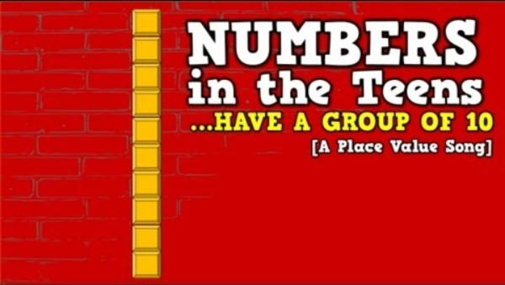
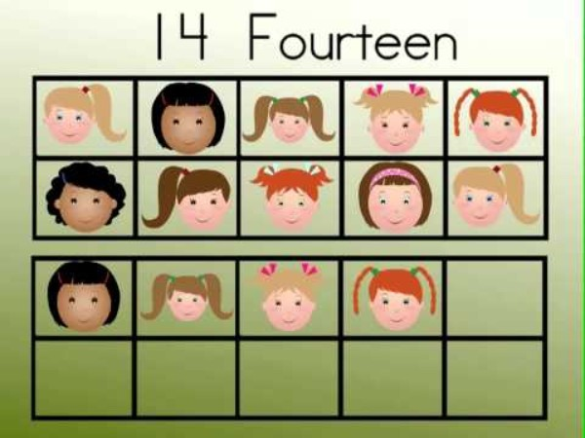
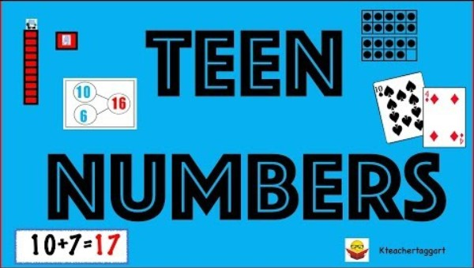

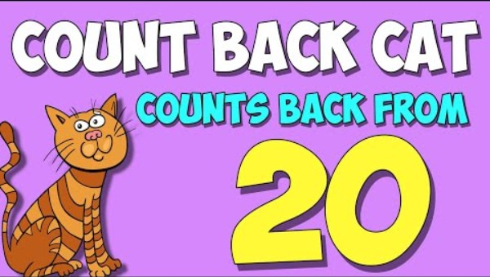
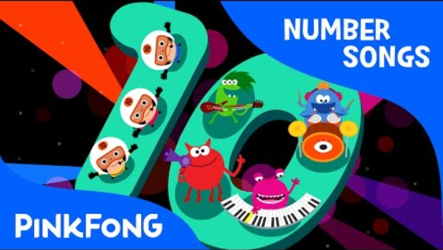
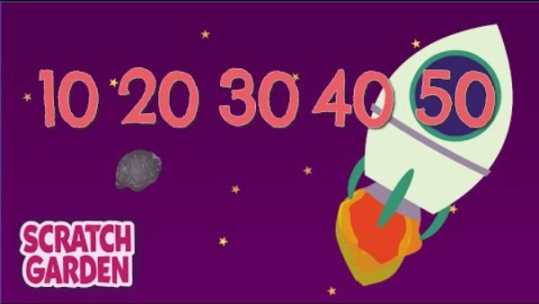
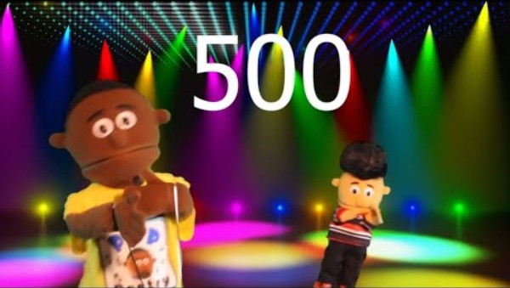
Counting songs
Click play, then the YouTube button for full-screen
Counting songs
Term 3
Progression:
Count to 3
Count to 5 and backwards
Count to 7
Count to 10 and backwards
Count to 20 and backwards
Count to 200 by tens (continue as a class, even if songs stop earlier than this)
Count to 120 by ones (continue as a class, even if songs stop earlier than this)
Count to 200 by ones
Count to 200 by fives (continue as a class, even if songs stop earlier than this)
Count to 120 by twos
20
20
20
20
20
20
20
20
20
By tens
By tens
By tens

Slide 8





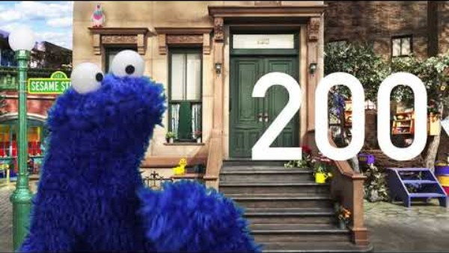

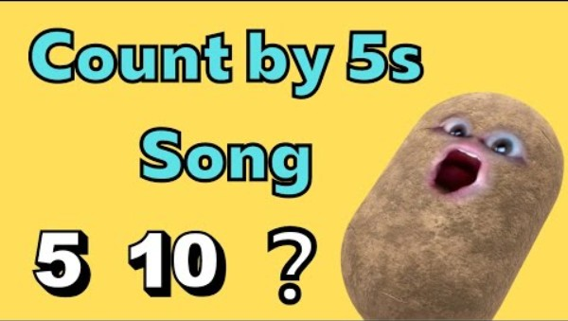
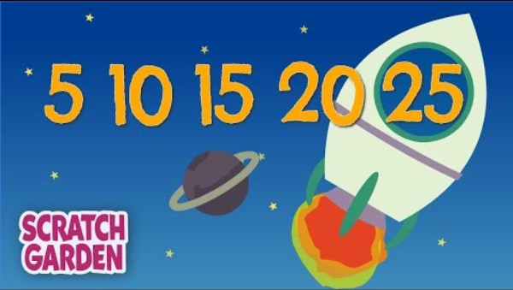
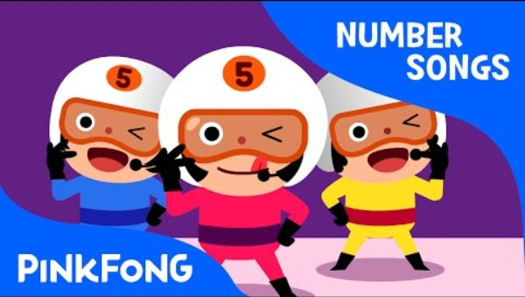
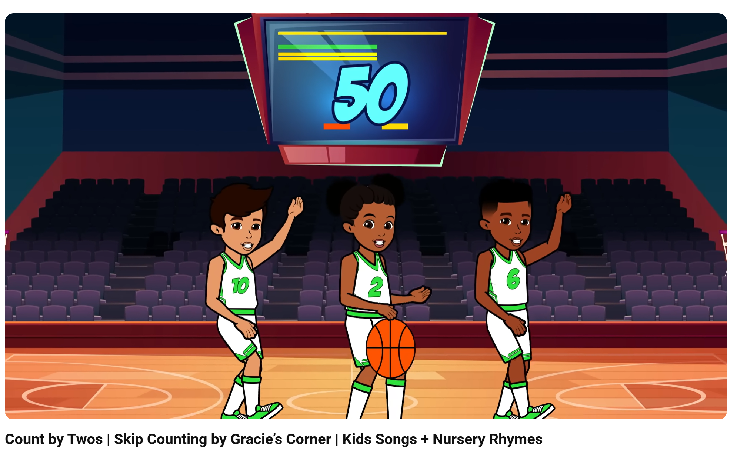
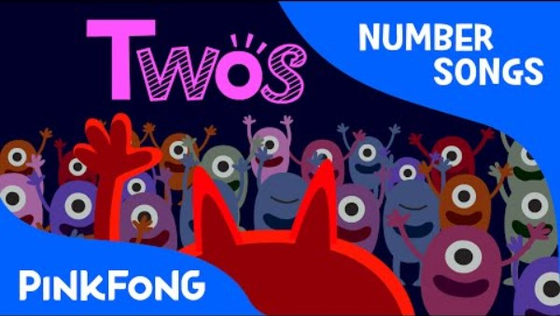
Counting songs
Click play, then the YouTube button for full-screen
Counting songs
Term 4
Progression:
Count to 3
Count to 5 and backwards
Count to 7
Count to 10 and backwards
Count to 20 and backwards
Count to 200 by tens (continue as a class, even if songs stop earlier than this)
Count to 120 by ones (continue as a class, even if songs stop earlier than this)
Count to 200 by ones
Count to 200 by fives (continue as a class, even if songs stop earlier than this)
Count to 120 by twos
100
100
100
100
100
200
By tens non-zero
By fives
By fives
By fives
By twos – click link
By twos

Slide 9
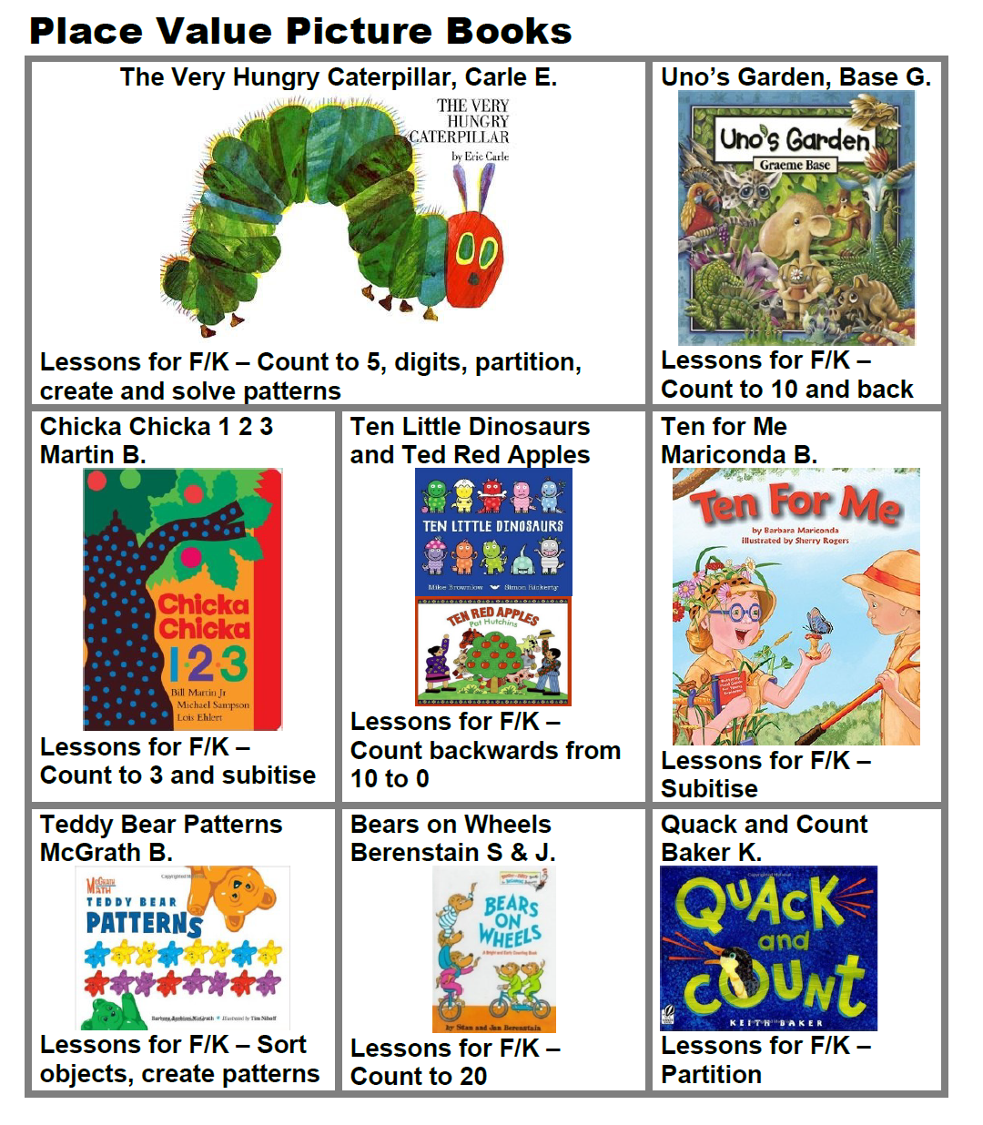
Alternative option Read a counting story or similar from the Numeracy Library Pack
Numeracy Library Pack – Catalogue by Concept or Catalogue by Level
https://www.toptenresources.com/numeracylibrary

Slide 10
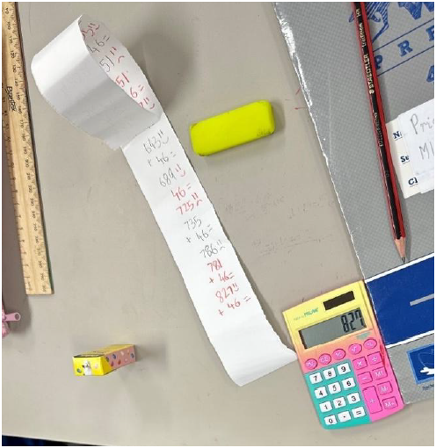
Extension option
Counting scrolls calculator patterns
Progression:
By ones from zero, then non-zero starts
By ones backwards
By tens forwards, then non-zero starts forwards, then backwards
By twenty, thirty forwards and backwards
By hundreds forwards and backwards
By fives from zero, then non-zero starts forwards and backwards
By twos from zero, then non-zero starts, forwards and backwards
By other skip-counting intervals (such as +9 thinking 10 more 1 less, or +8 thinking 10 more 2 less, +7 thinking 10 more 3 less)
By tens and ones
(+23 using split strategy thinking 2 tens more than 3 extra ones, +49 thinking 5 tens more 1 less, +97 thinking +100 take away 3)
Guess, commit (in grey lead) then press to check (red pencil)

Slide 11
a grip mat
Students collect
in a grab-and-go container:
their current dice for the one-minute roll
ninja slider
write-and-wipe sleeve with number bonds in side A and digit road in side B
Ideally, all in a grab-and-go box with write-and-wipe sleeve underneath.

Slide 12
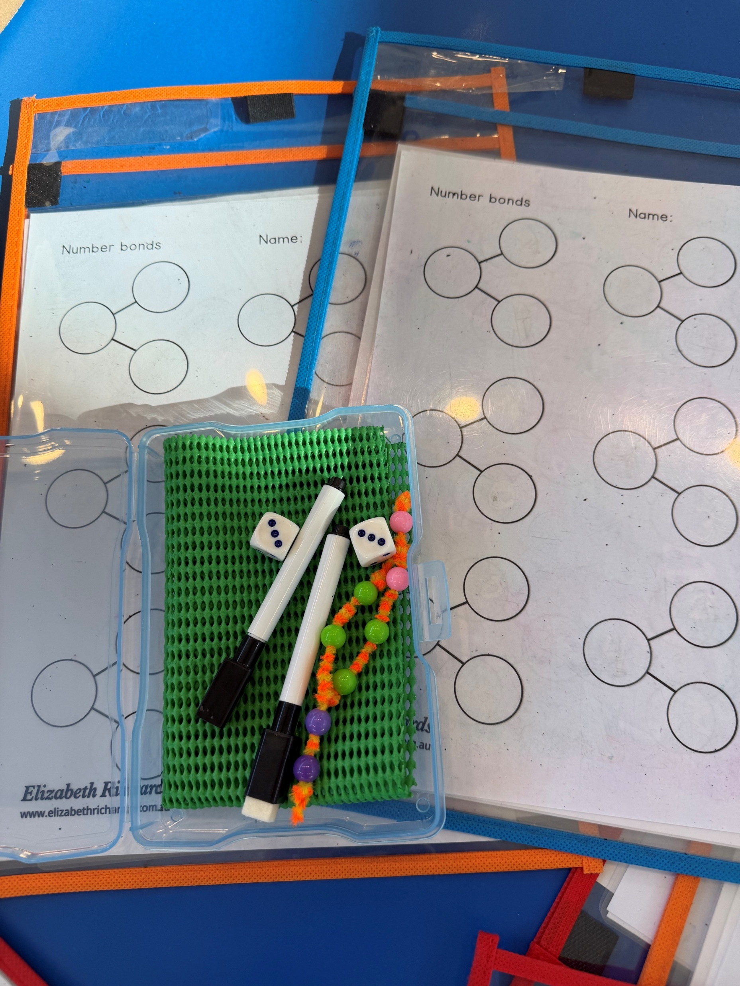
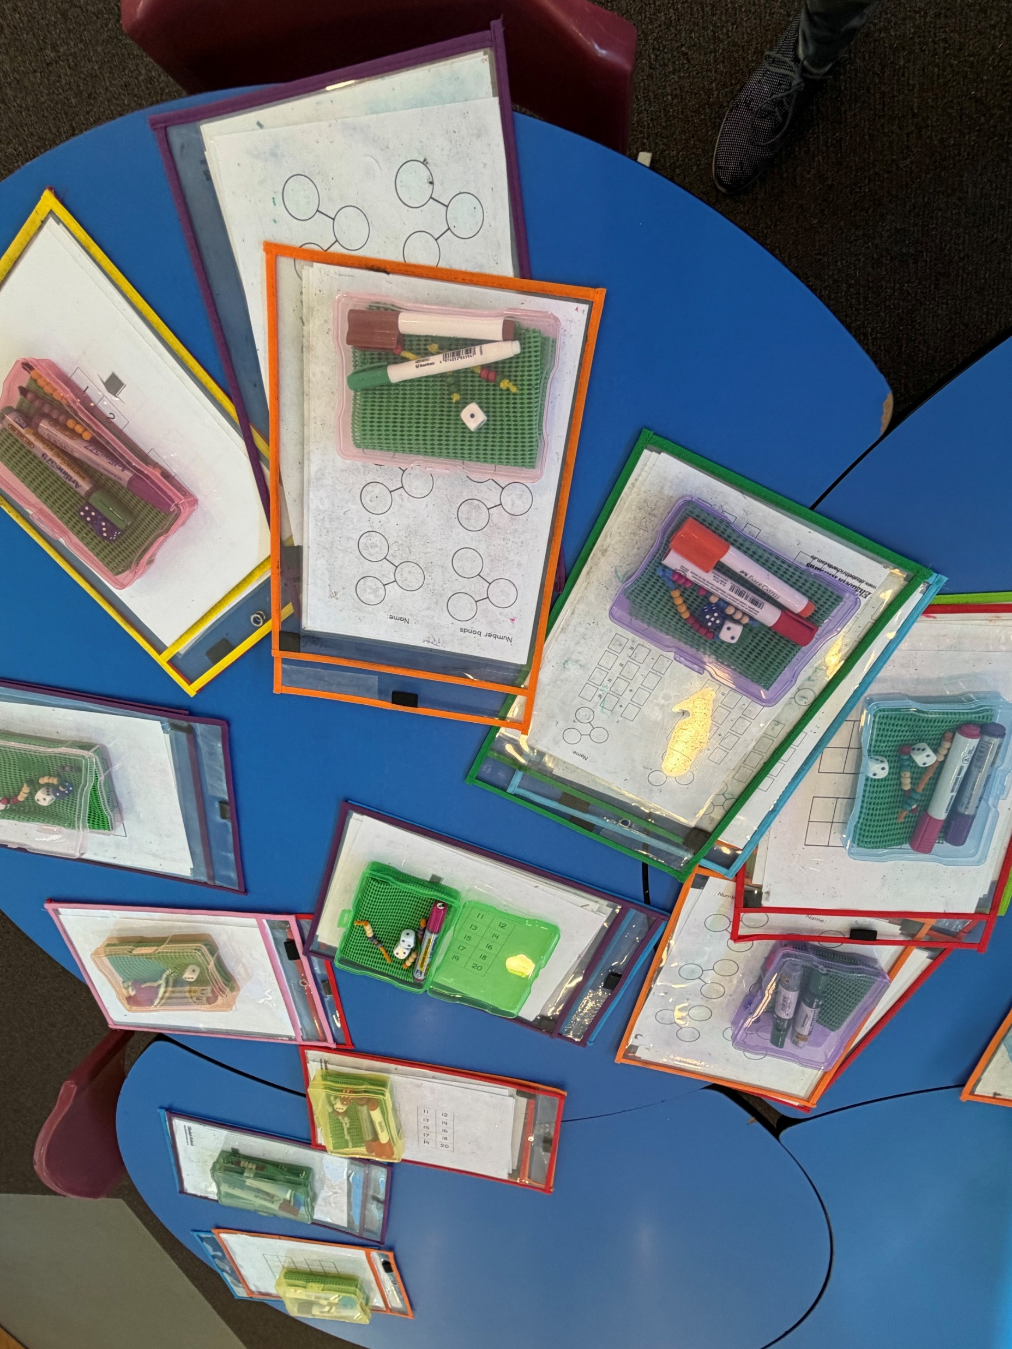

Slide 13

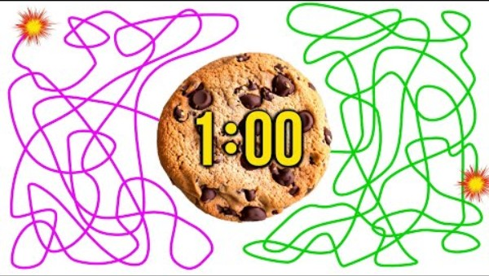
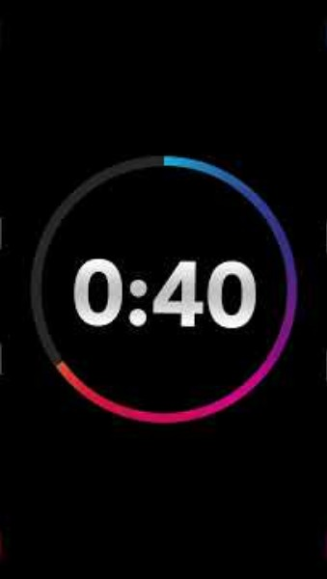
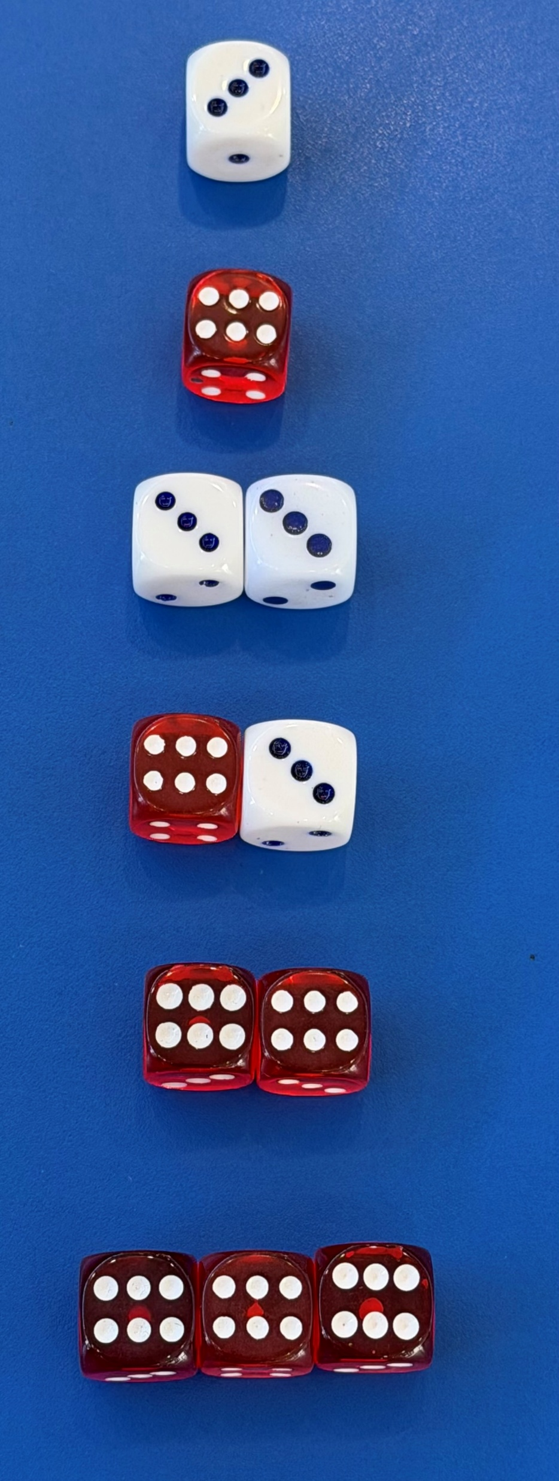
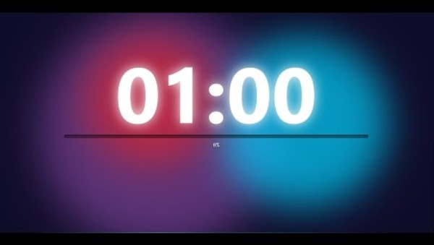

One-minute roll
Progression:
One 3-dot
One 6-dot
Two 3-dot dice
One 3-dot and one 6-sided
Two 6-dot dice
Three 6-dot dice
Partner A says what they see on the dice (the total of the roll), while Partner B rolls, checks and collects token to tally partner A’s personal best score attempt.
Race against yourself/your previous best scores for one minute, then swap and do the same for your buddy.
Notes:
At point-of-need.

Slide 14
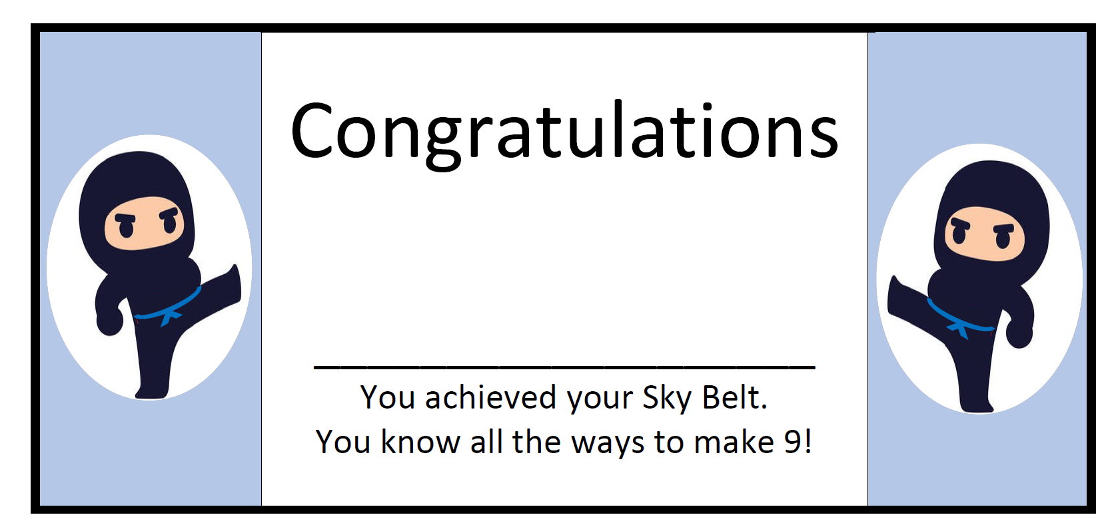
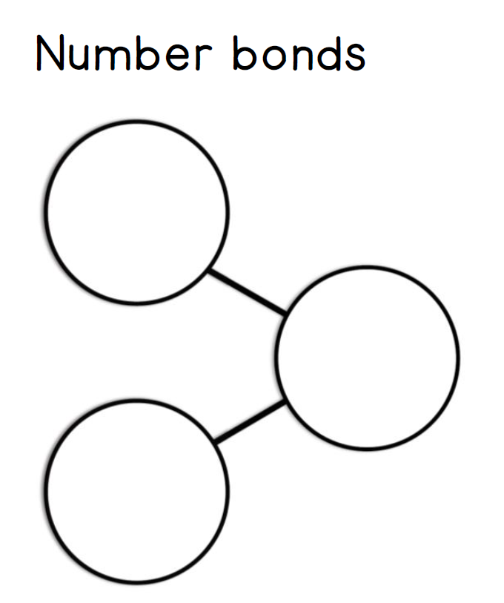
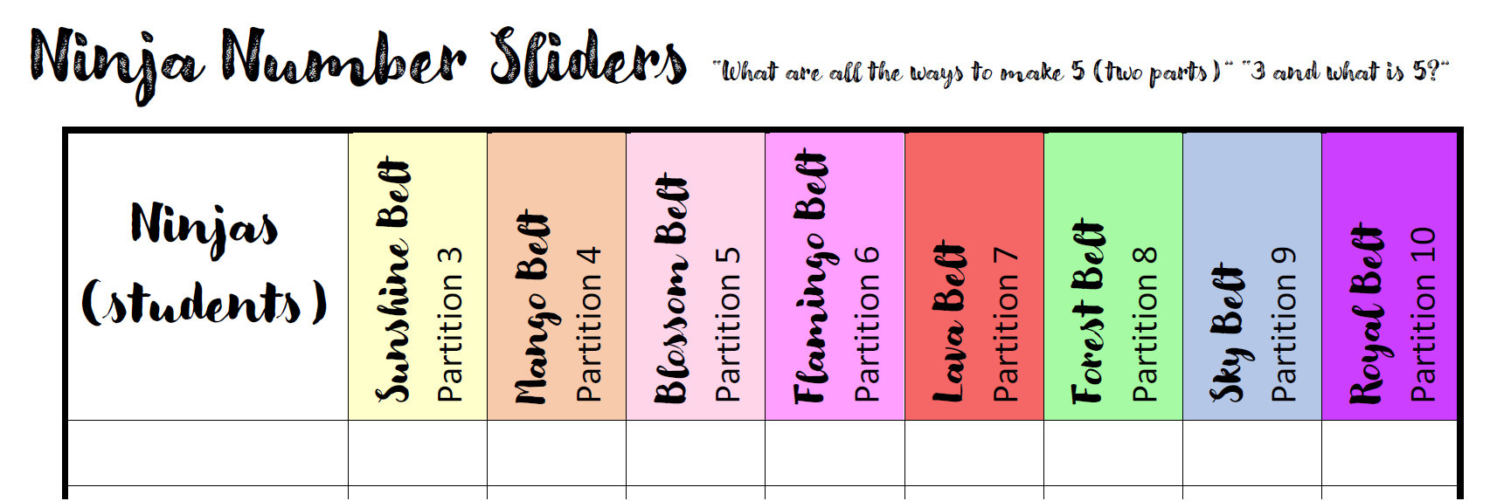
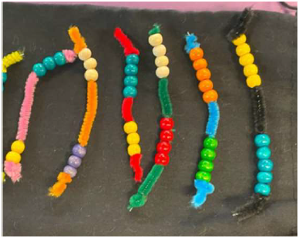
Ninja slider practice
Early Years Package
Addition Unit 4 – Lesson 1
Use your current ninja slider to practise all the ways to make and break that total: “4 and 4 is 8, 5 and 3 is 8, 3 and 5 is 8, 6 and 2 is 8, 2 and 6 is 8, 7 and 1 is 8, 1 and 7 is 8, 8 and 0 is 8, 0 and 8 is 8.”
Record on a write-and-wipe sleeve with the number bonds.
Sign-up for a teacher test once a fortnight when ready (orally only, must be fluent and able to be done out-of-order, and includes missing part question, “What are all the ways to make 5?” “2 and what makes 5?”).
Any students who progress beyond the ninja sliders work on the missing part cards.
Notes:
Current ninja slider practice.

Slide 15
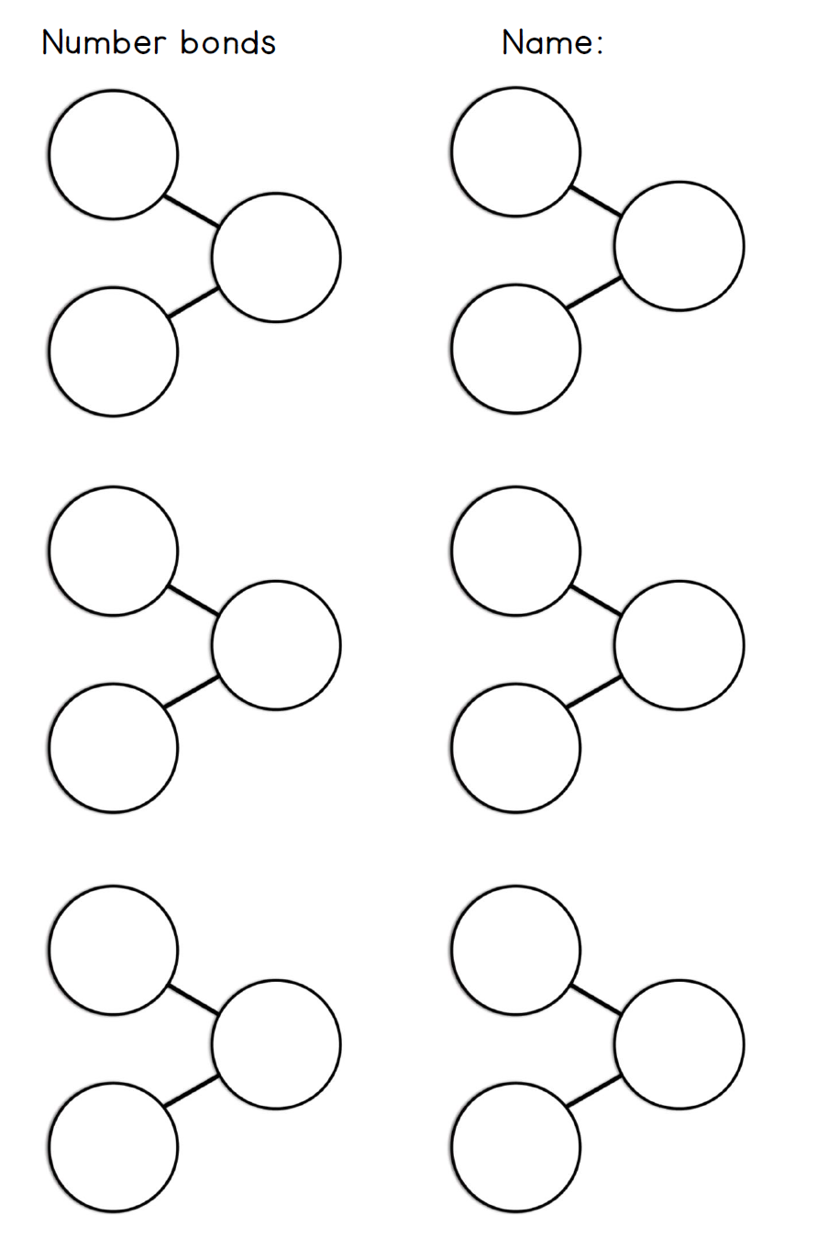
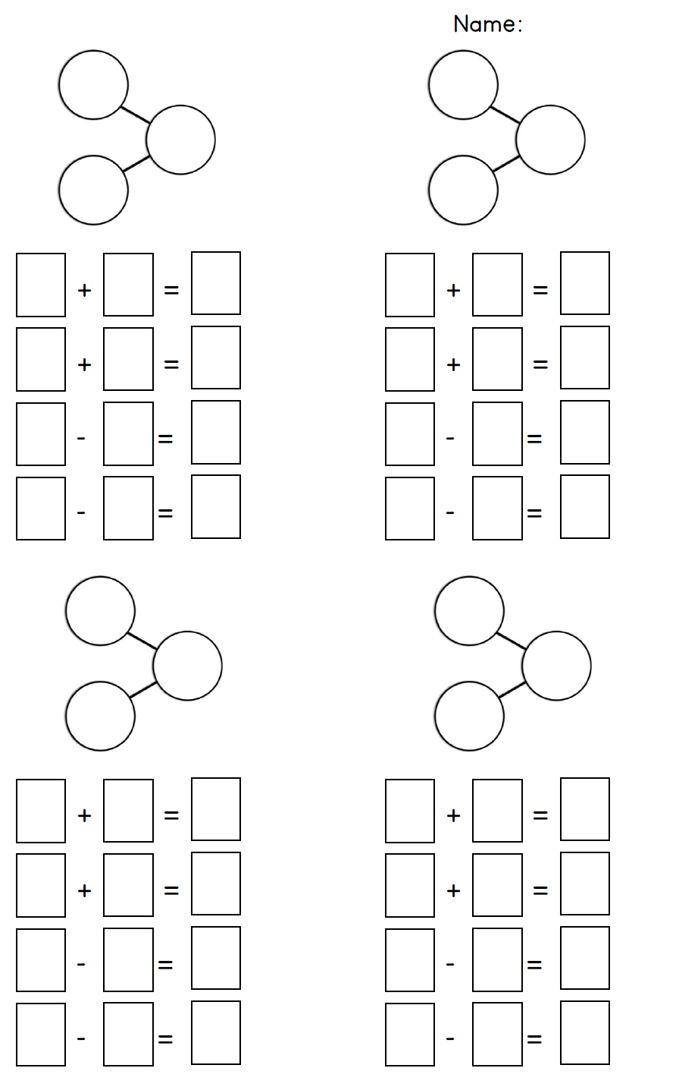
Regular number bonds for students to record while practising ninja sliders
Extension number bond for students to record while practising ninja sliders or missing part cards

Slide 16
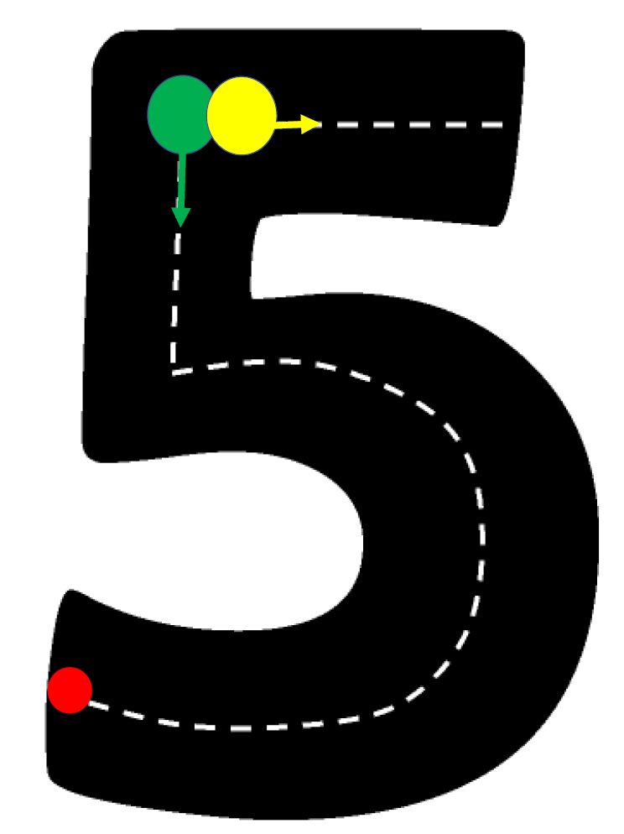
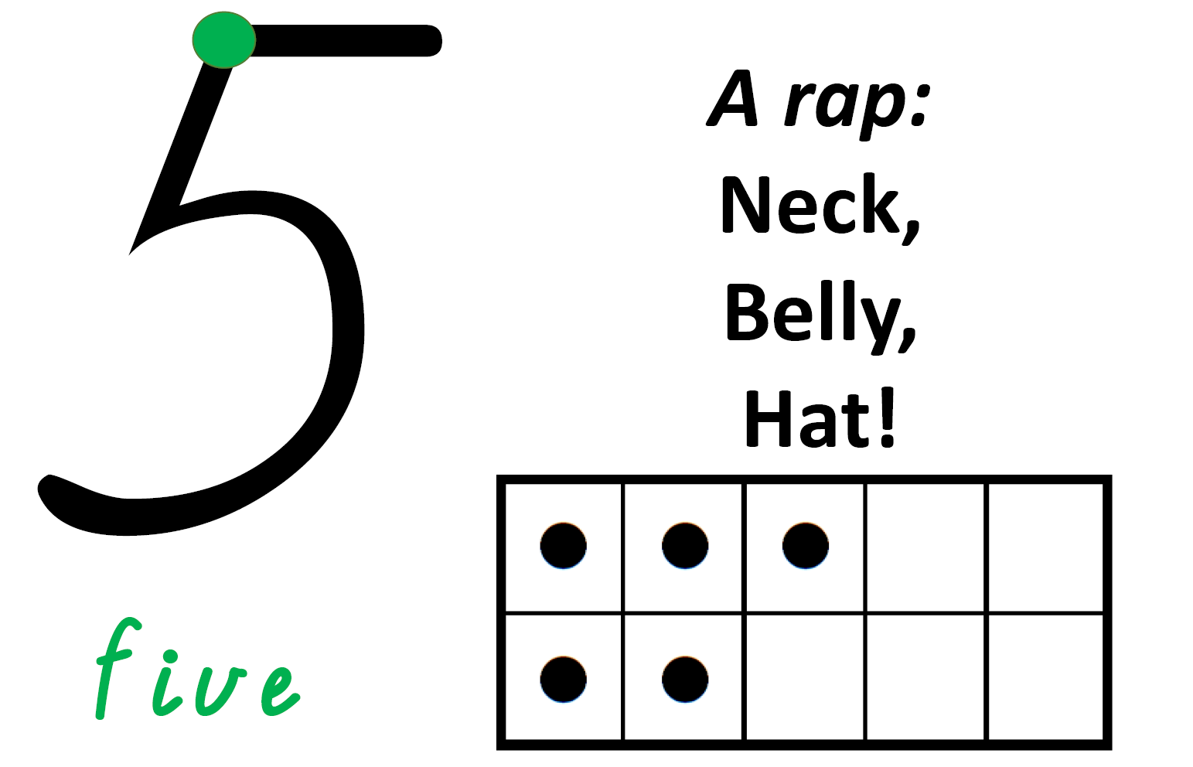
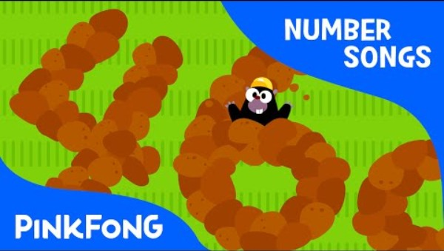
Digit road
Early Years Package Place Value Unit 4 – Lesson 1
Sign the song together and trace the digit road with a green pompom/button/counter. Then flip over and continue on the back of the sheet, tracing approximately 30 repeats of that digit.
Teacher allocates the class focus based on a digit that is frequently being reversed or poorly formed (only one digit each day). Later, allocate digits by points-of-need to small groups or individually, once students know the routine well.
Notes:
Point-of-need teacher choice for whole-class, then groups once students can run the song themselves in small groups.

Slide 17
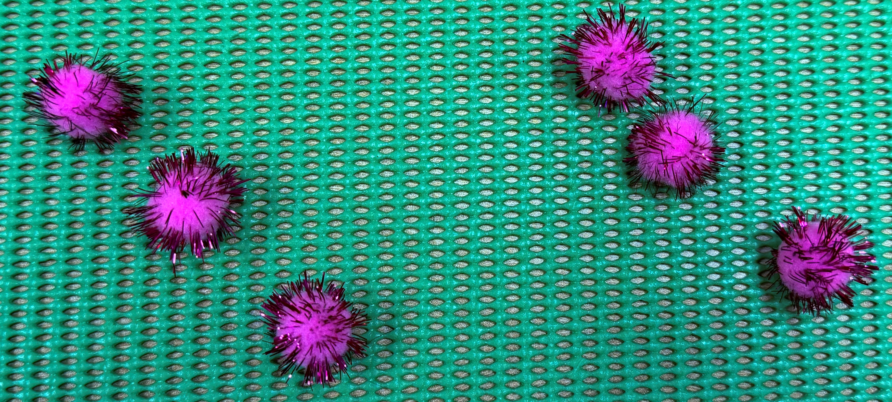
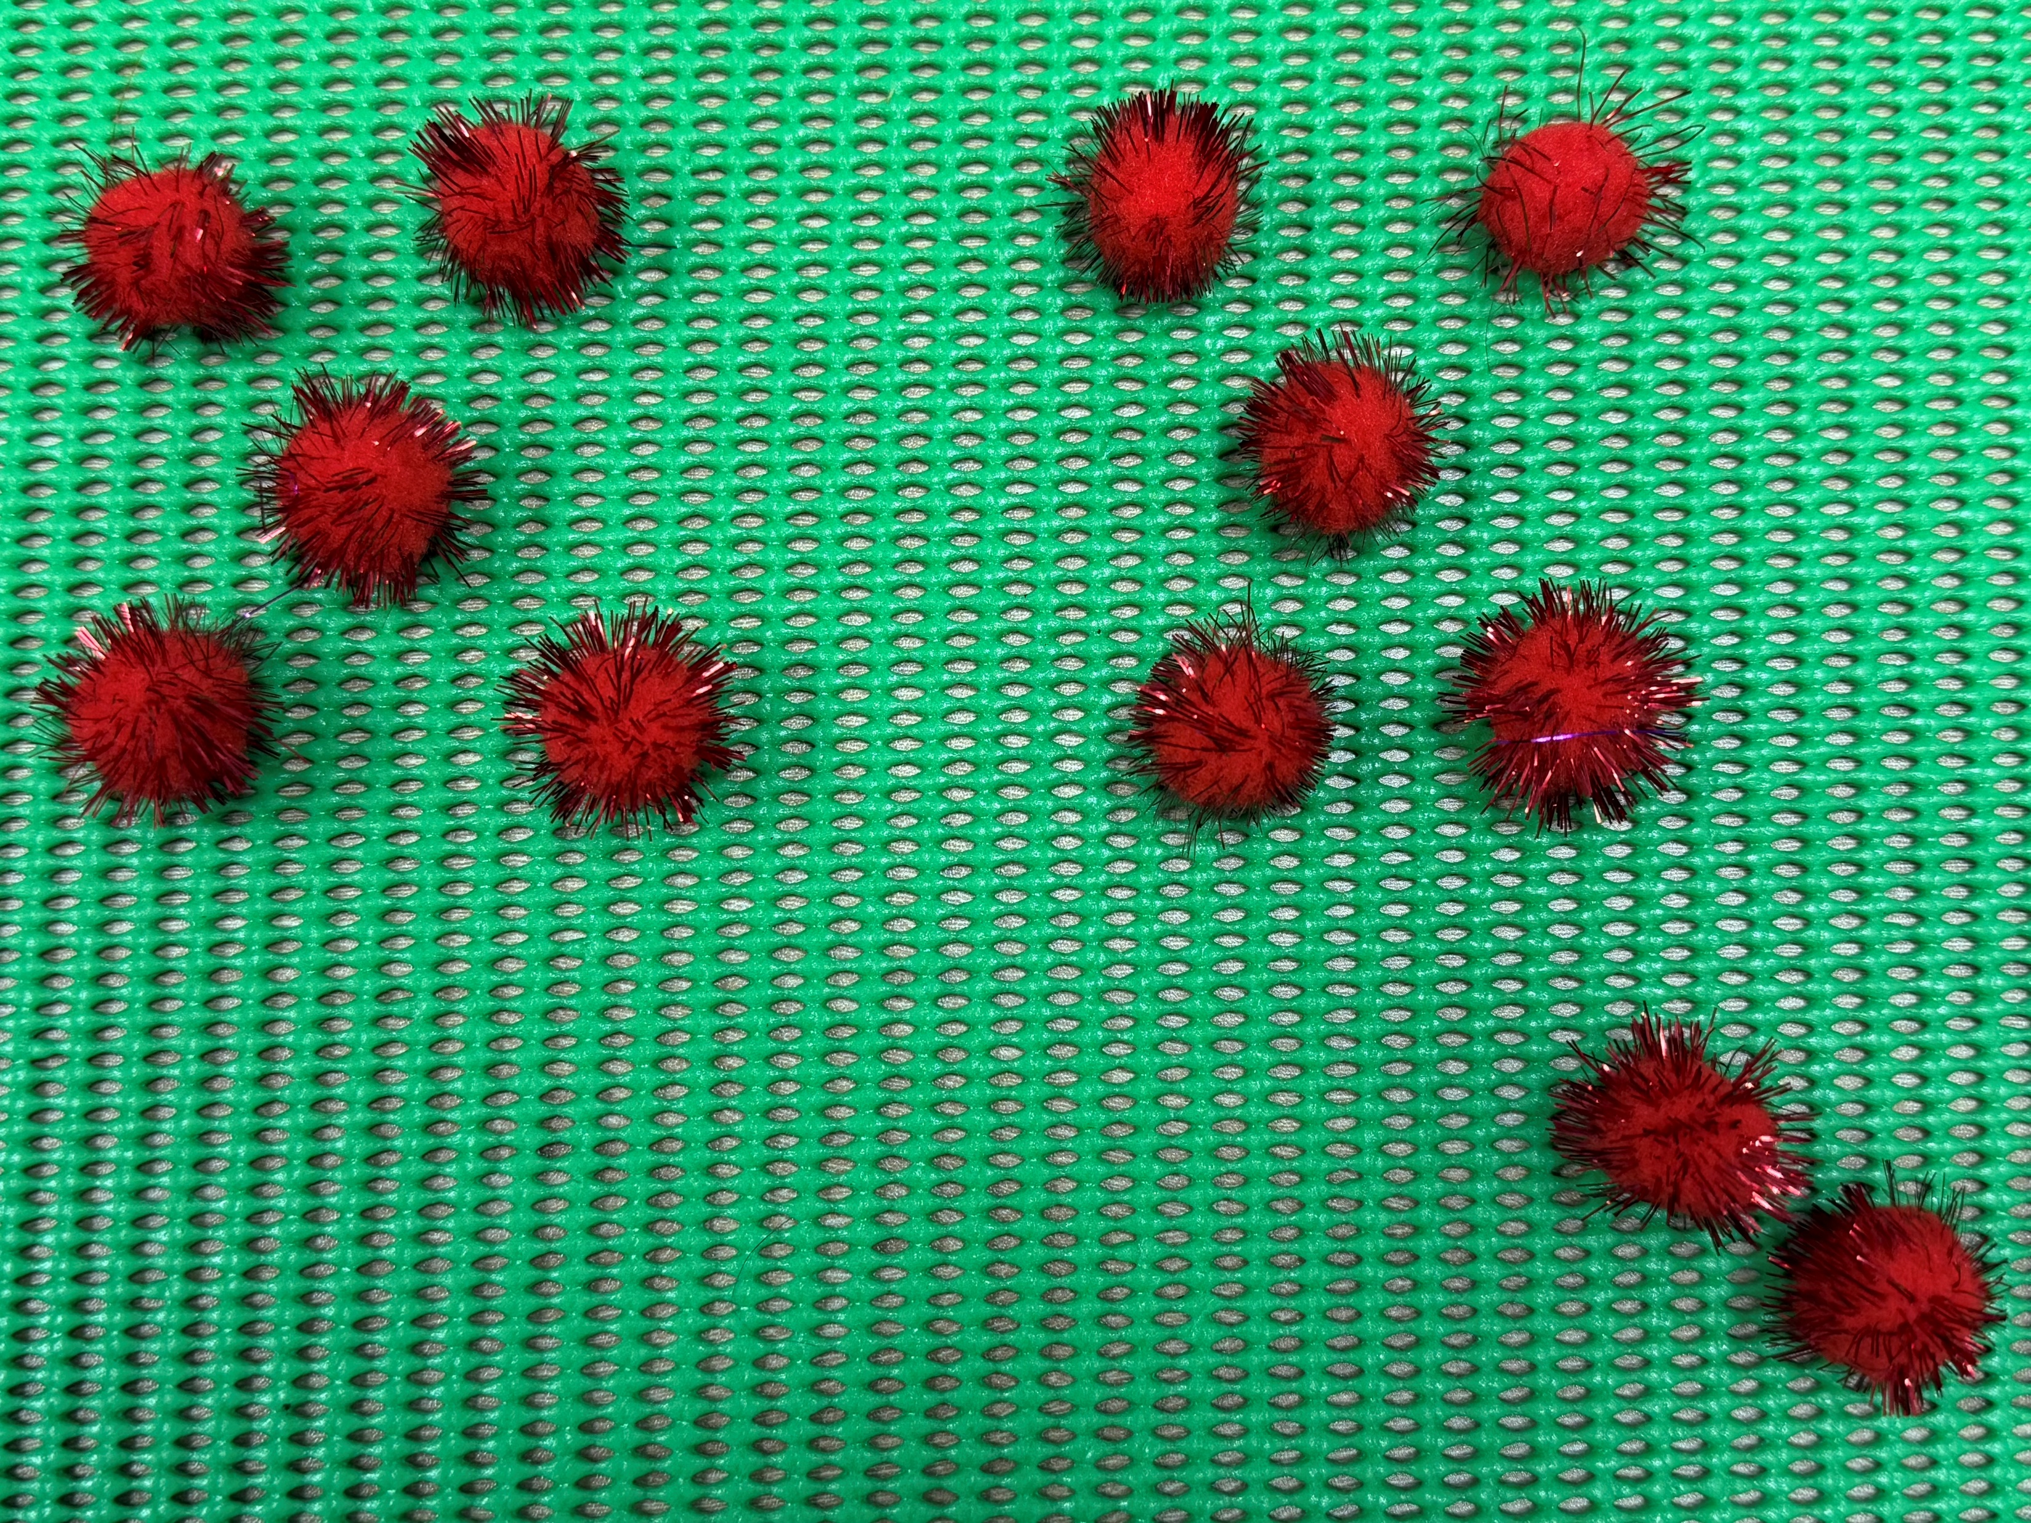
Optional extra A: Counting handfuls or estimation handfuls
Progression:
Each student is given a handful of items (on their grip mat).
Students are challenged to arrange the items in a way that makes them easy to count, then count one-to-one, or use “I see” (superhero eyes/subitising) to solve the total.
When ready, students are given larger handfuls and asked to estimate the total, before arranging items in subitising patterns (fives, tens or twos) to skip-count the total.

Slide 18
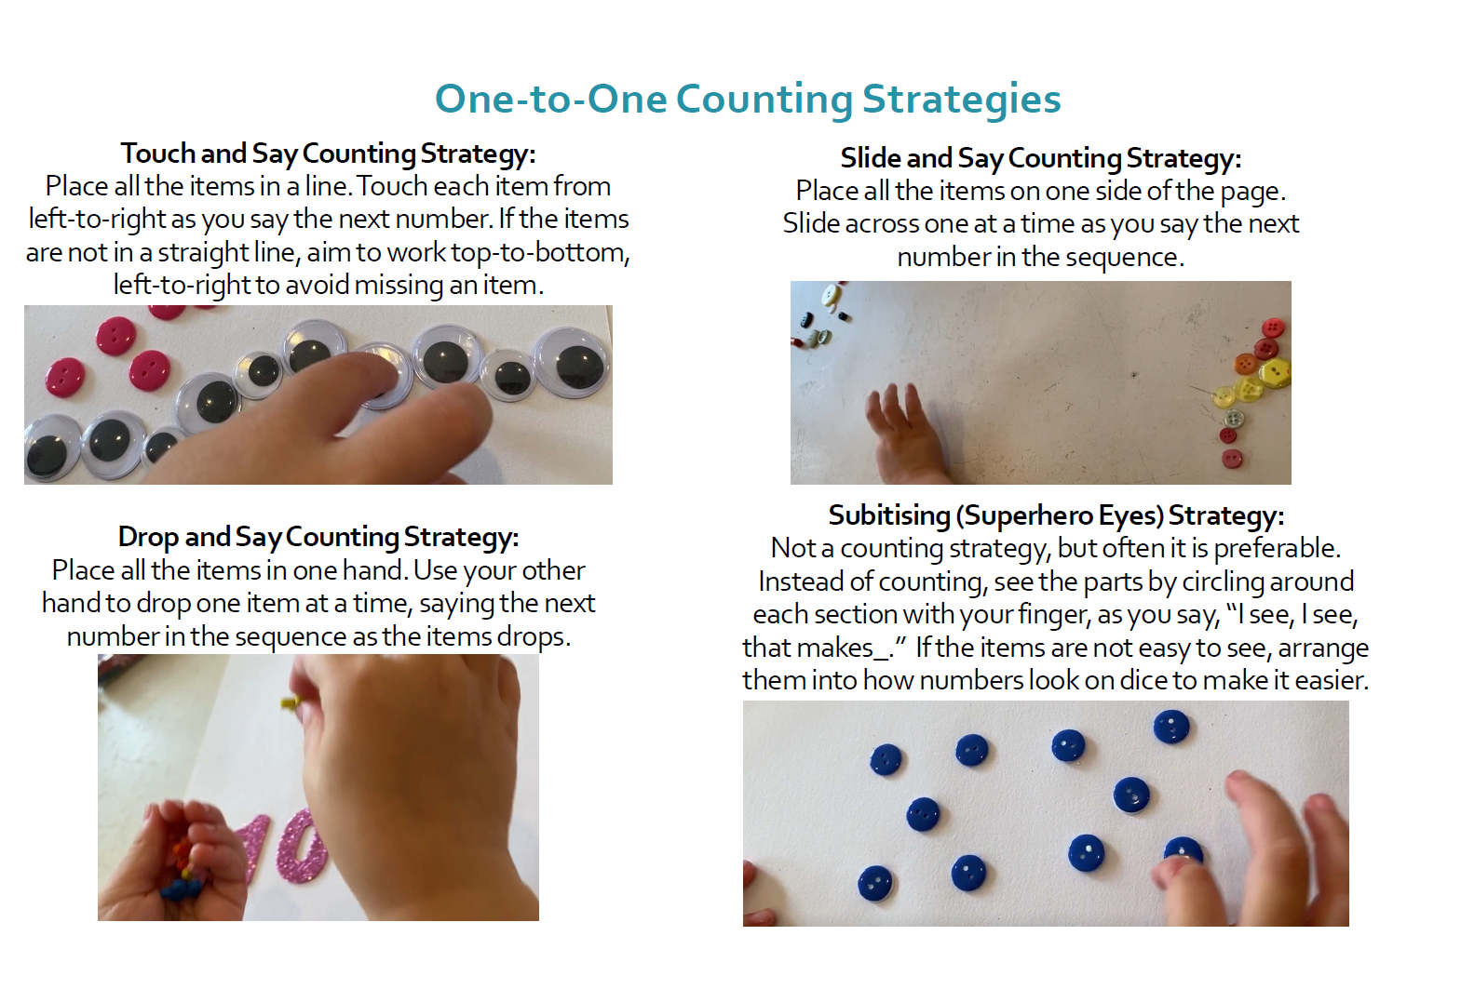

Slide 19
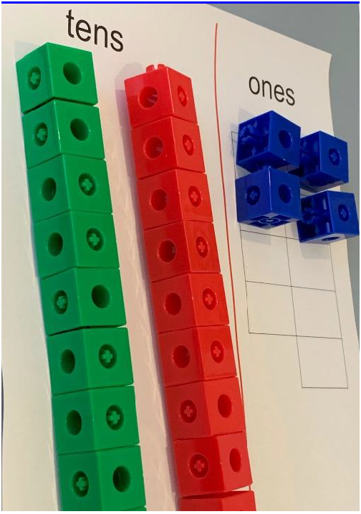




Optional extra B: Make and write a two-digit number
(told orally to the whole-class)
Progression:
Teen number (17) by counting using counters in ten frames with immediate feedback, then unifix cubes, then popsicle sticks (twist a pipe cleaner around them to bundle it, without the fine motor difficulties of rubberbands)
Two-digit numbers that follow the language pattern (4t 5, 6t 7, 8t 1, 9t 3) using popsicle stick bundles, then place value tens blocks (MAB)
Two-digit numbers that do not follow the language pattern (5t 7, 3t 5, 2t 6) using popsicle stick bundles, then place value tens blocks
Teen number and counterpart (31 and 13)

Slide 20

Research-informed and results-informed approach to numeracy: Top Ten Mathematics at Chirnside Park Primary School
2026 NAPLAN Results - Six years of implementing Top Ten Mathematics whole-school across all teams with ongoing in-person PL each year from one of our numeracy coaches
0% needs additional support in Year 3
91% strong or exceeding in Year 3
0% needs additional support in Year 5
91% strong or exceeding in Year 5
98% participation rate
https://www.toptenresources.com /

