Slide 1
Making numbers

Slide 2
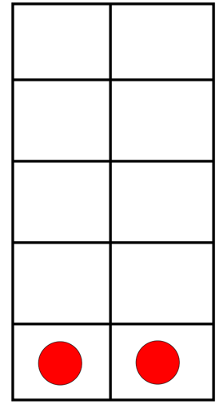
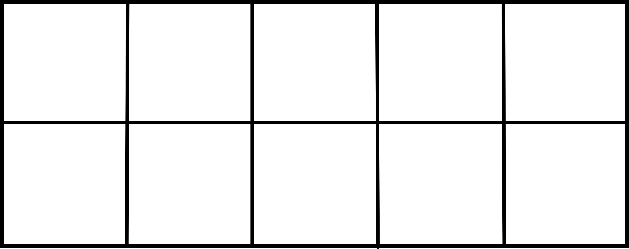
Make 2

Slide 3
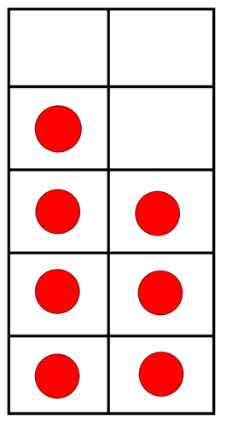
Make 7

Slide 4
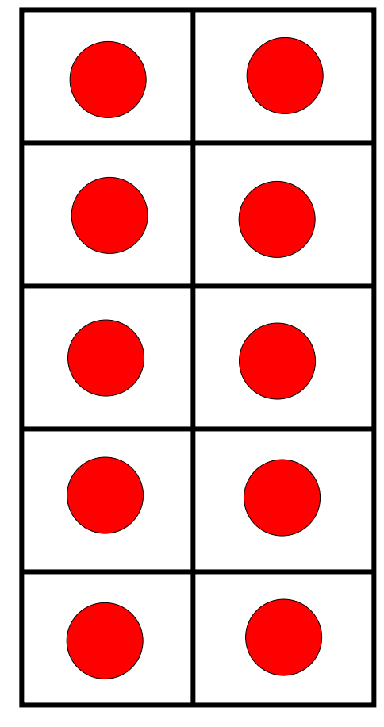
Make 10
1 0

Slide 5
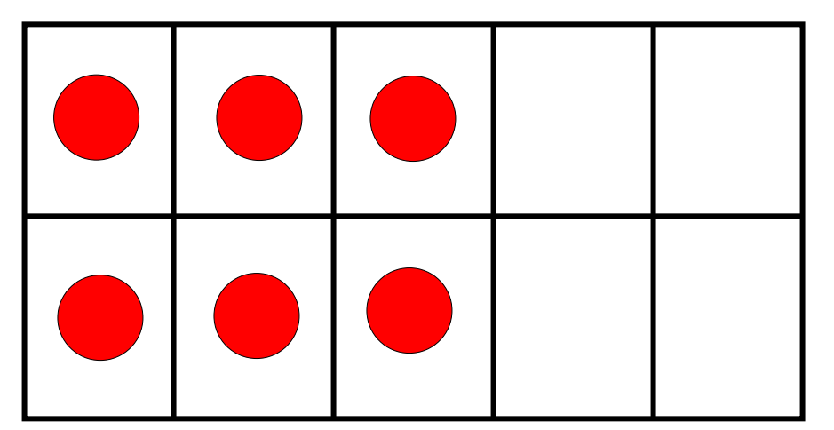
Make 6

Slide 6
Make 16
1 6

Slide 7
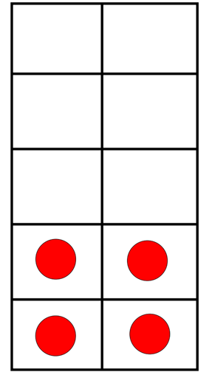
Make 14
1 4

Slide 8
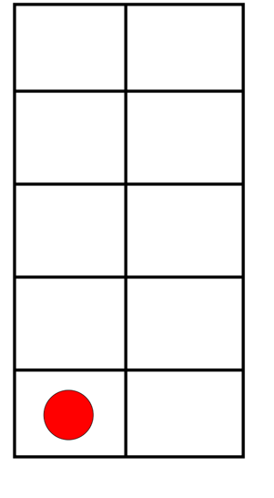
What do you think 41 look like?
4 tens and 1 more
So 41 is NOT the same as 14

Slide 9
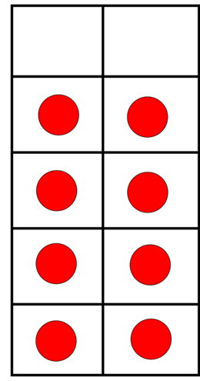
Make 18
1 8

Slide 10
Make 12
1 2

Slide 11
What do you think 21 look like?
2 tens and 1 more
So 21 is NOT the same as 12

Slide 12
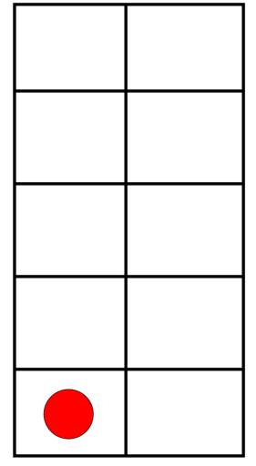
Make 11
1 1

Slide 13
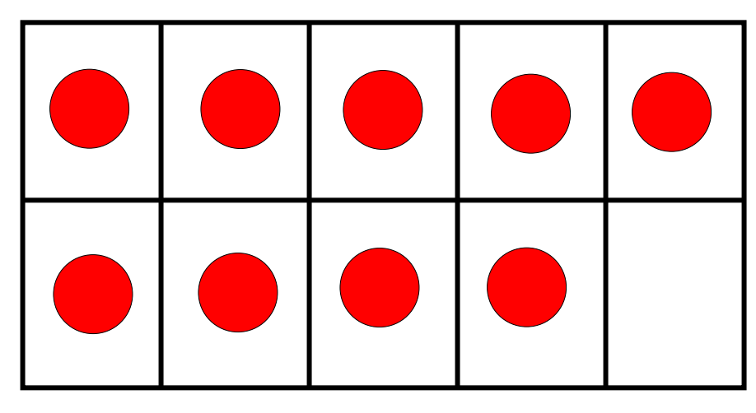
Make 9

Slide 14
Make 19
1 9

Slide 15
This is what 91 looks like:
9 tens and 1 more
91 is NOT
the same as 19

Slide 16
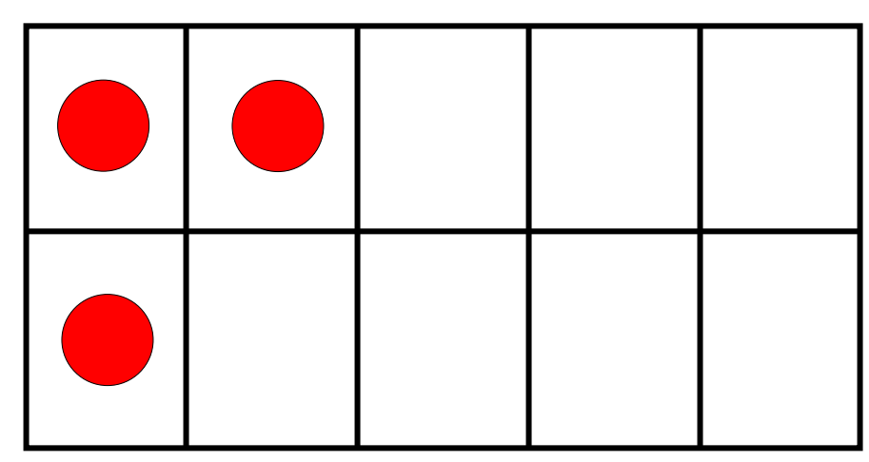
Make 3

Slide 17
Make 13
1 3

Slide 18
What do you think 31 look like?
3 tens and 1 more
So 31 is NOT the same as 13

Slide 19
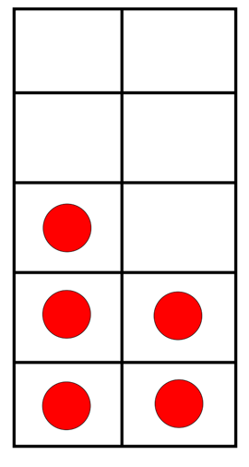
Make 15
1 5

